Slide 1
Autonomous Target Search In A Dynamic Environment Using Model Predictive Control
Chang Liu

Slide 2
Background
Robots have been applied for various search applications
Indoor search
Search-and-rescue
Search-and-identify
Powerful tools have been developed
Probabilistic search framework

Slide 3
Two remaining issues
Path planning method
Greedy approach (myopic plan)
Multi-step planning (involve numerical integration over large state space)
Few works consider the collision avoidance during the search process

Slide 4
Contributions
Scenario:
A ground robot equipped with a binary sensor to localize a stationary target in the dynamic environment.
Potential applications: search-and-rescue mission
Contributions:
Derive an explicit form of the objective function in MPC
Potential to reduce computation burden
Enforce collision avoidance with obstacles in a dynamic environment

Slide 5
Formulation
Robot kinematic model
Binary sensor model
Motion of moving obstacles
Constant velocity and orientation

Slide 6
Updating the probability map
Probability map
Update law
Will be used for computing the objective function in MPC for path planning

Slide 7
Path planning using MPC
Formulation

Slide 8
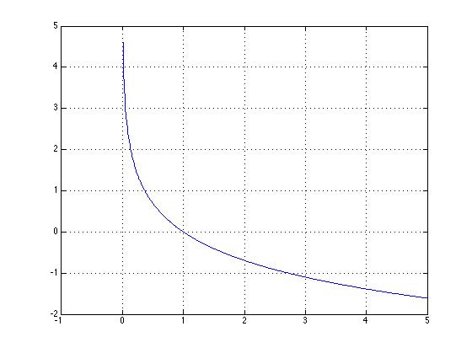
Three cost functions
Non-detection cost function
Collision avoidance cost function
Terminal cost function

Slide 9
Non-detection cost function
Traditional works numerically calculate this integral
Probability map
Sensor model

Slide 10
Derive the explicit form
A property of Gaussian functions:
The product of Gaussian functions is a Gaussian function
If
then

Slide 11
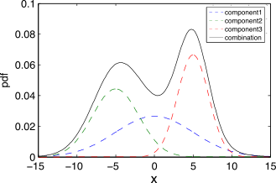
Derive the explicit form
Approximate the probability map with a Gaussian Mixture Model (GMM)
GMM
Non-detection cost function

Slide 12
Explicit form of the non-detection cost function

Slide 13
Simulation

Slide 14
Simulation

Slide 15
Conclusion
Present an autonomous target search approach using a ground robot to localize a stationary target in a dynamic environment
MPC for planning a finite-horizon optimal search while avoiding collision with surrounding obstacles
Derive an analytical form of the objective function in MPC for the purpose of reducing the computation complexity of the path planning process
Notes:
Conclusion to course, lecture, et al.

Slide 16
Future work
Speedup of solving the MPC
The objective function is non-convex and nonlinear
Convex relaxation and branch-and-bound method
Motion prediction for realistic obstacles (e.g., pedestrians)
Regression methods from Machine Learning

